Slide 1
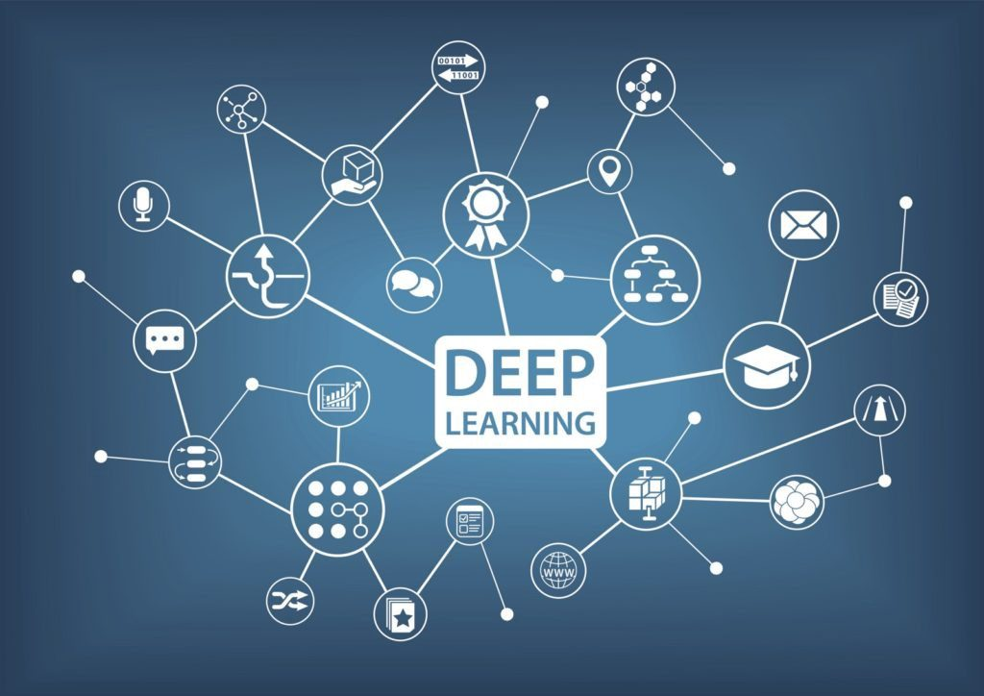
Recurrent Neural Networks(RNNs)
Presented by
NAME
Anamika Banwari
Victor Eghujovbo
Manikanta Teja Gullapalli
October 27, 2023
Presented to: Dr Yasser Alginahi
Source: https://tinyurl.com/34k38nut
1

Slide 2

Table of contents
RNN recap
LSTM
GRU
Applications
Advantages and limitations of RNN
Attention
Transformers
source: https://tinyurl.com/2p8mcjep

Slide 3
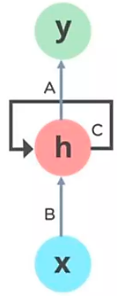
Sequence Modeling (RNN): Design Criteria
To model sequences, we need to:
Handle variable-length sequences
Maintain information about order
Share parameters across the sequences
Track long-term dependencies
was
Ex: ‘’The person who took my bike, ………………. a thief ”
source: https://tinyurl.com/tsfcmx75
Recurrent Neural Networks (RNNs) meet these sequences modeling design criteria
3

Slide 4
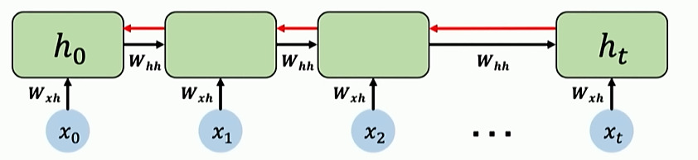
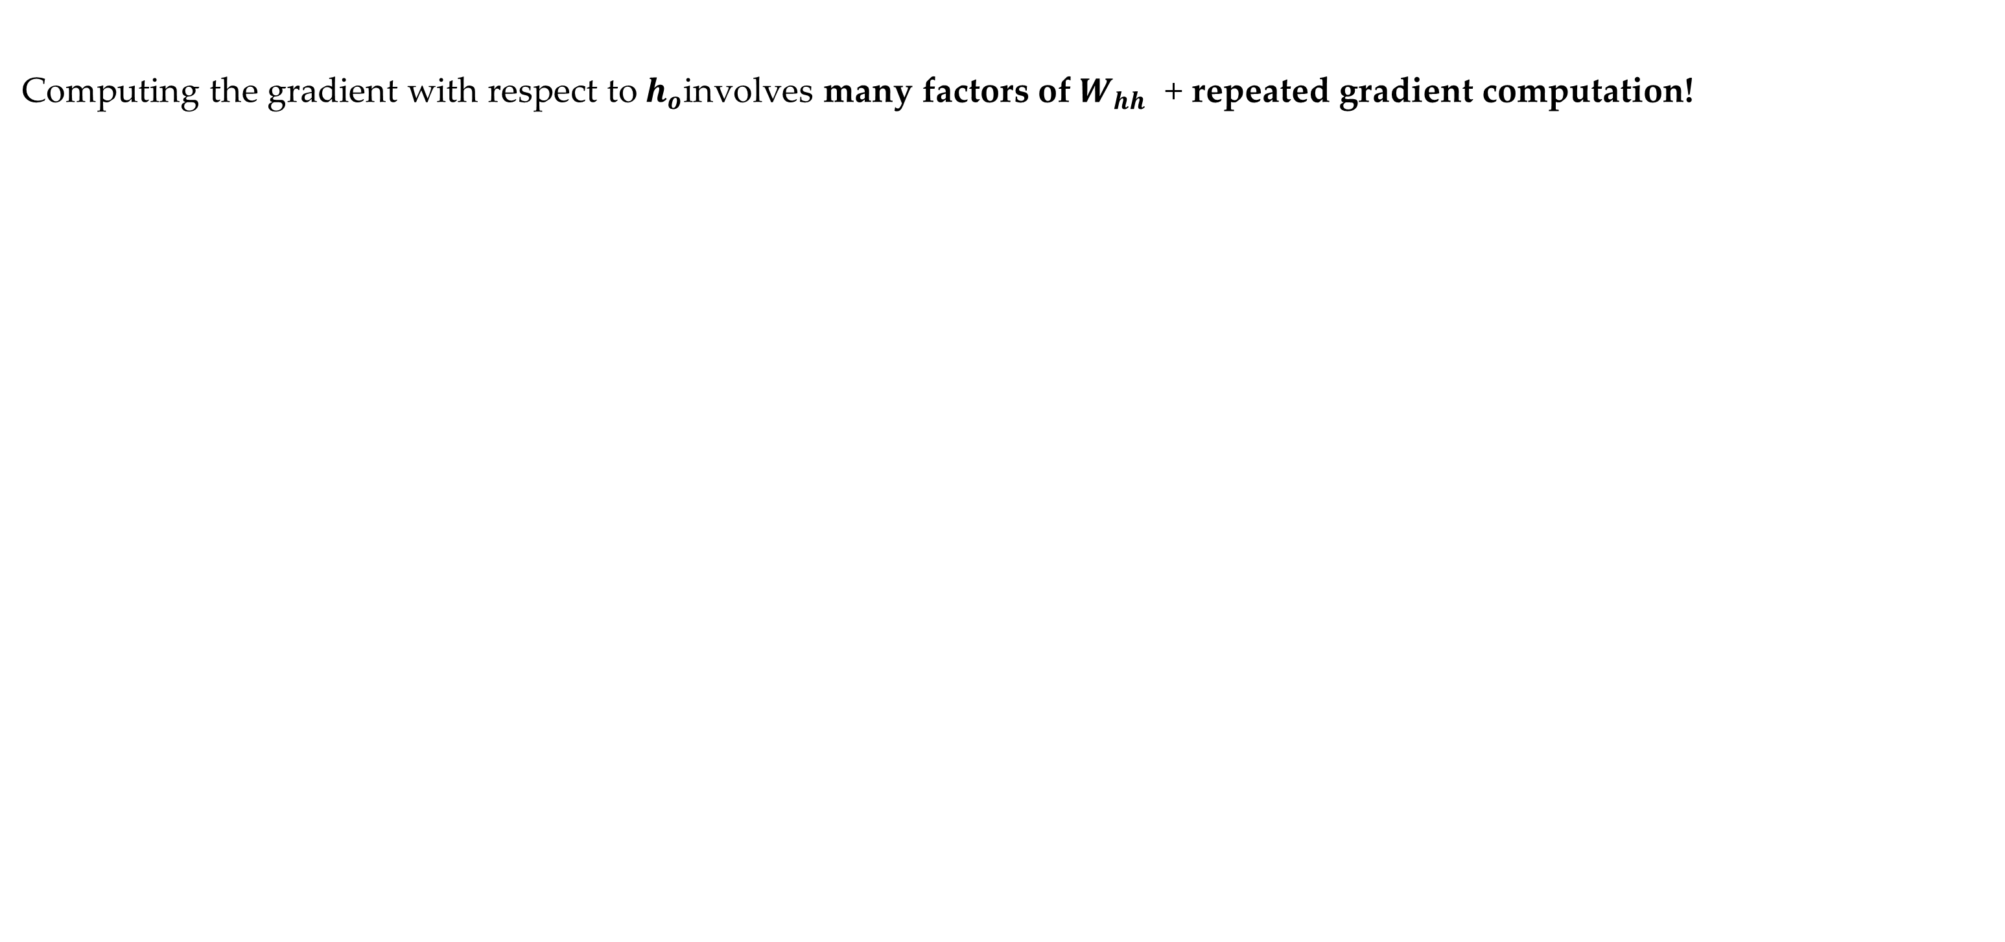
Standard RNN Gradient Flow: Vanishing Gradients
Where $h_{o}$ is the prediction from backward propagation Reference: https://tinyurl.com/3xyrn62w
$h_{t}$ is the hidden layer prediction at time t
$x_{0}$,$x_{1} and x_{2}$are the input vectors.
$W_{hh}$ and $W_{xh}$ are weights at the hidden layer and from the input vectors
Computing the gradient with respect to $h_{o}$involves many factors of $W_{hh}$ + repeated gradient computation!
Many Values < 1: (vanishing gradients)
Activation functions
Weight initialization
Network architecture
4

Slide 5
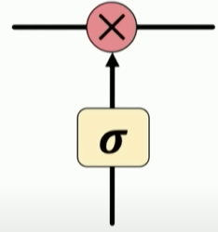
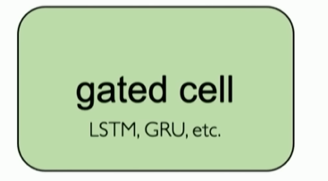
Gated Cells
Idea: use gates to selectively add or remove information within
each recurrent unit with
Point wise multiplication
Sigmoid neural net layer
Gates optionally let information through the cell
Reference: https://tinyurl.com/3xyrn62w
Long Short-Term Memory (LSTM) networks rely on a gated cell to track information throughout many time steps.
5

Slide 6
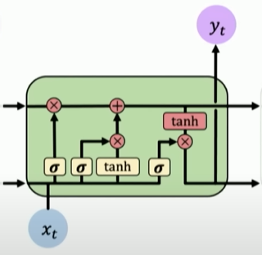
Long Short-Term Memory (LSTM)
Gated LSTM cells control information flow:
Forget
2) Store
3) Update
4) Output
LSTM is capable of learning long-term dependencies.
Remembering information for long periods of time
Reference: https://tinyurl.com/3xyrn62w
6

Slide 7
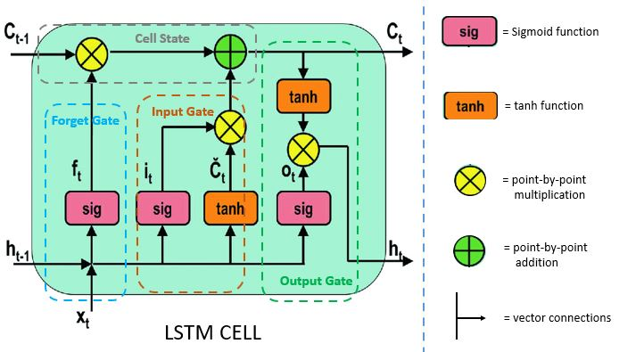
Structure of LSTM
It consists of:
Four interactive layers
Gated unit
3 logistic sigmoid gates
1 cell state
Reference : https://tinyurl.com/3xyrn62w
7

Slide 8
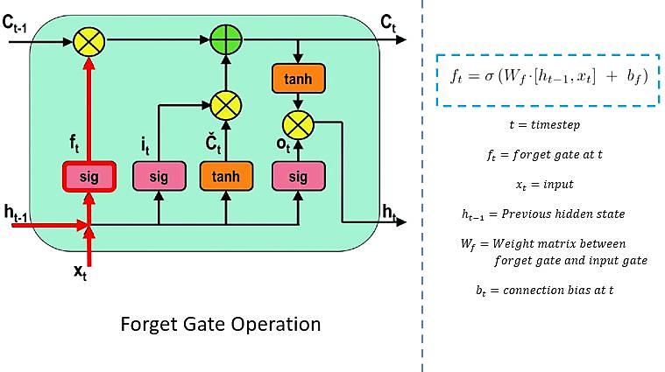
3 logistic sigmoid gates
FORGET GATE
Reference : https://tinyurl.com/3xyrn62w
8

Slide 9
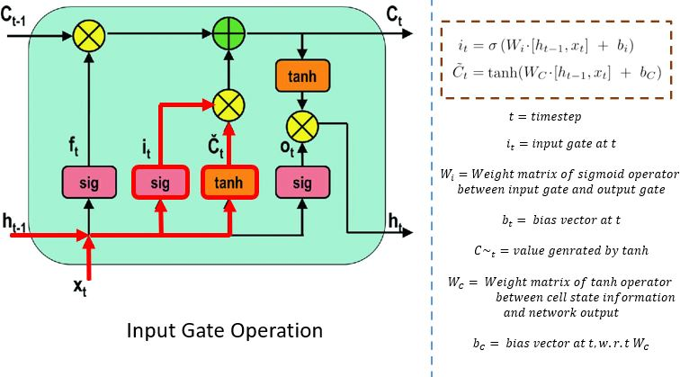
INPUT GATE
Reference : https://tinyurl.com/3xyrn62w
9

Slide 10
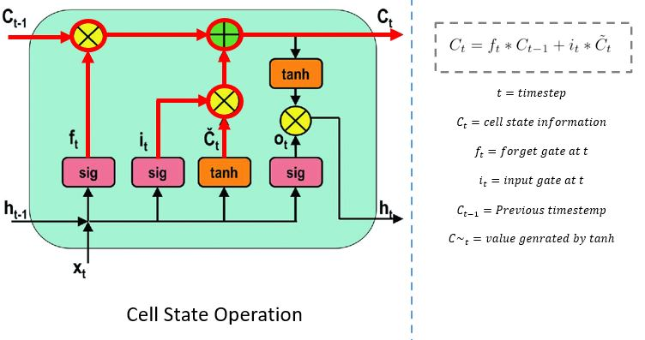
Cell State
Reference : https://tinyurl.com/3xyrn62w
10

Slide 11
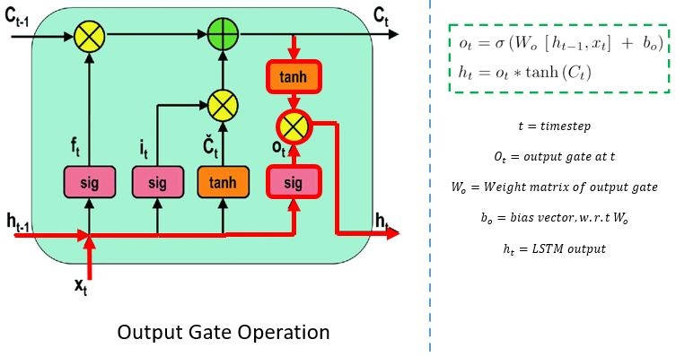
OUTPUT GATE
Reference: https://tinyurl.com/3xyrn62w
11

Slide 12
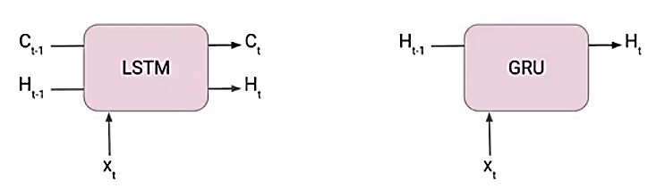
Optimized RNN!
Gradient clipping
Avoid the vanishing/exploding gradient problem by looking at a threshold and clip the gradient.
Simple to address the issue but might hamper the performance.
For system optimization LSTM was introduced and much recently GRU.
Reference : https://tinyurl.com/y9b8desy
12

Slide 13
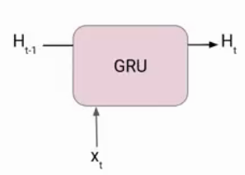
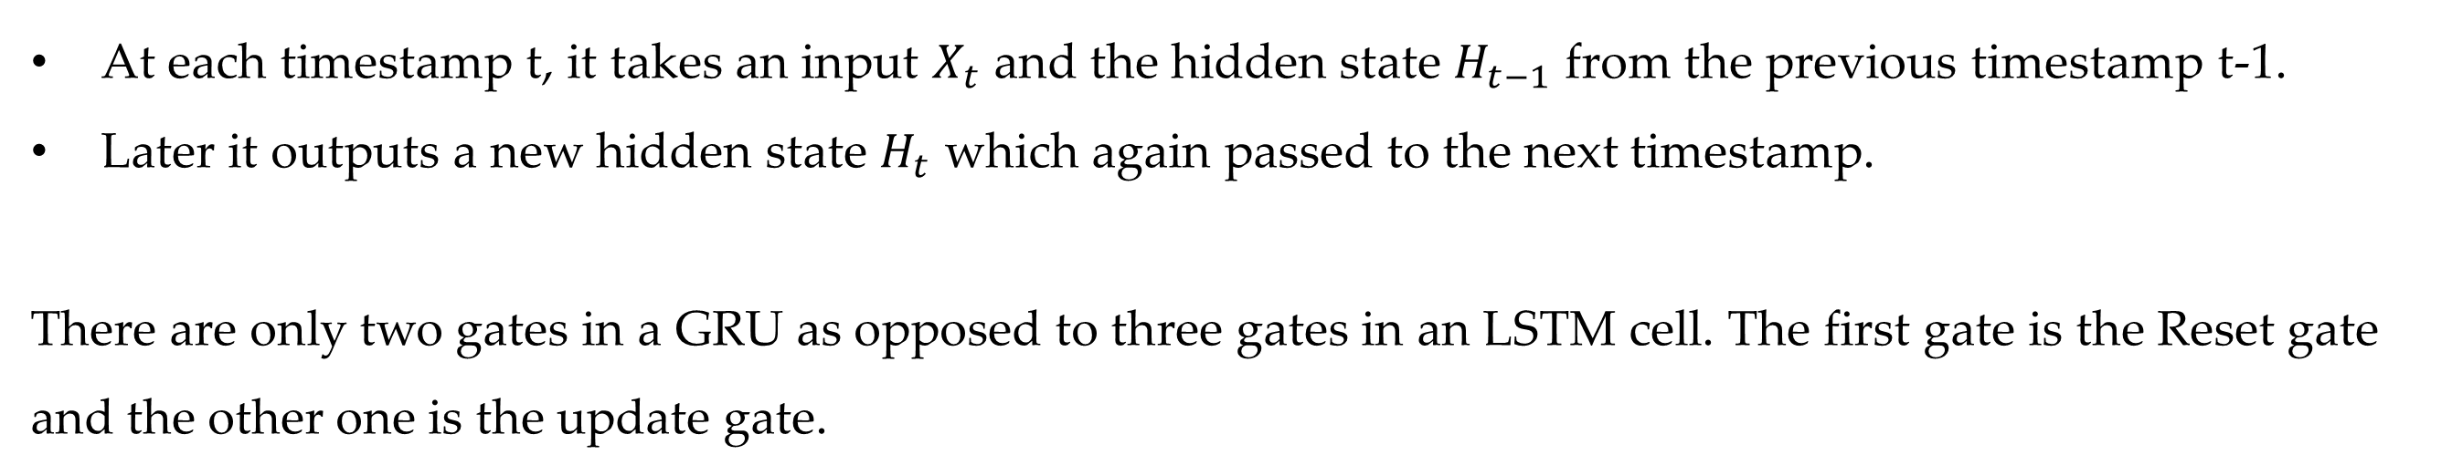
The Gated Recurrent Unit (GRU) architecture.
Reference : https://tinyurl.com/n7djd7ax
At each timestamp t, it takes an input $X_{t}$ and the hidden state $H_{t−1}$ from the previous timestamp t-1.
Later it outputs a new hidden state $H_{t}$ which again passed to the next timestamp.
There are only two gates in a GRU as opposed to three gates in an LSTM cell. The first gate is the Reset gate and the other one is the update gate.
13

Slide 14
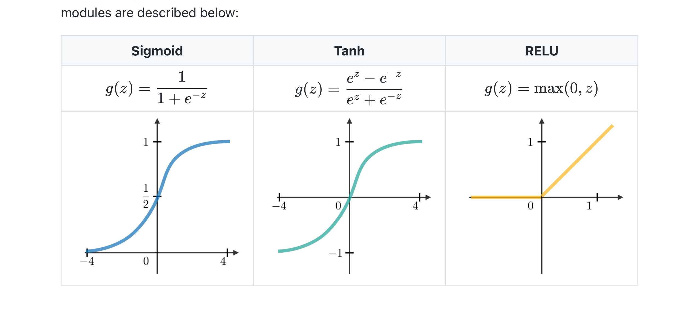
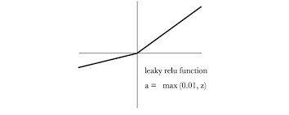
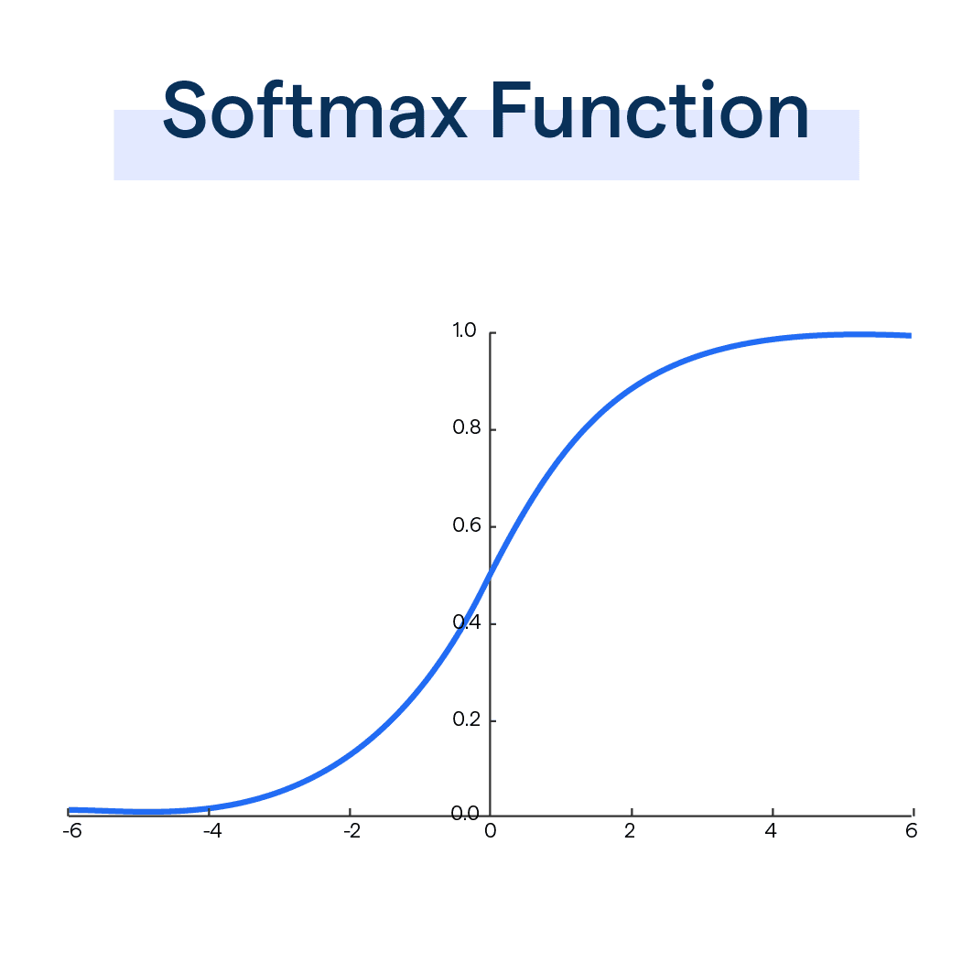
Common Activation Functions
Leaky Relu Function
Leaky ReLU(x) = max(0.01x, x).
SoftMax Function
SoftMax(x) = e^x / ∑(e^x)
Reference : https://tinyurl.com/n7djd7ax
14

Slide 15
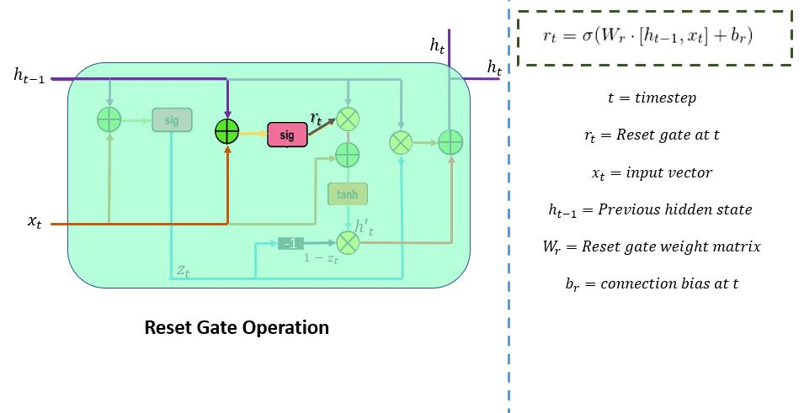
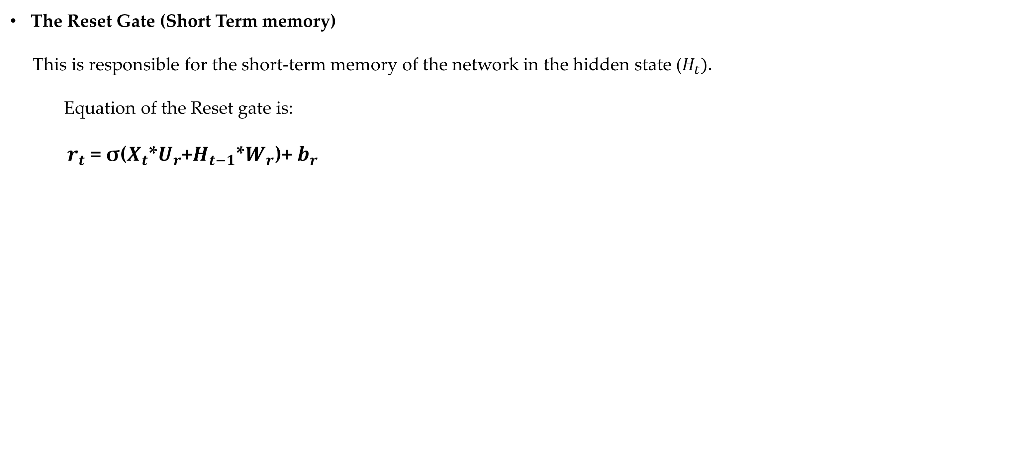
GRU Gate and memory allocation
The Reset Gate (Short Term memory)
This is responsible for the short-term memory of the network in the hidden state ($H_{t}).$
Equation of the Reset gate is:
$r_{t}$ = σ($X_{t}$*$U_{r}$+$H_{t−1}$*$W_{r}$)+ $b_{r}$
$U_{r}$ and $W_{r}$ are weight matrices for the reset gate.
Reference: https://tinyurl.com/5n933r7c
15

Slide 16
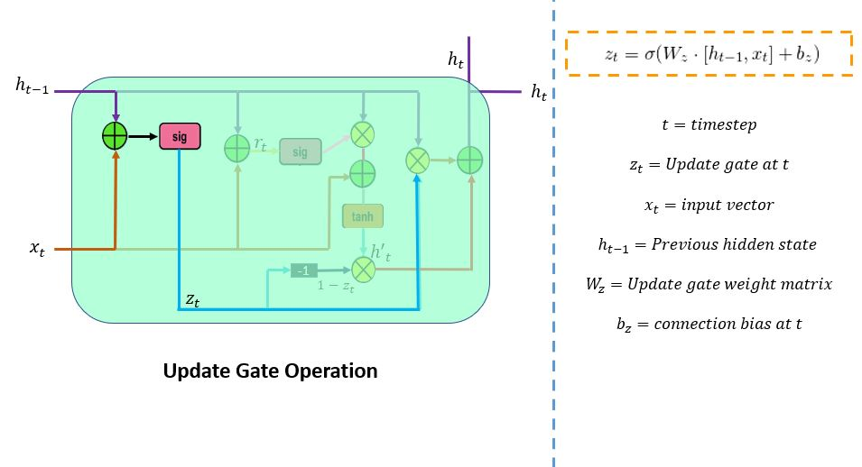
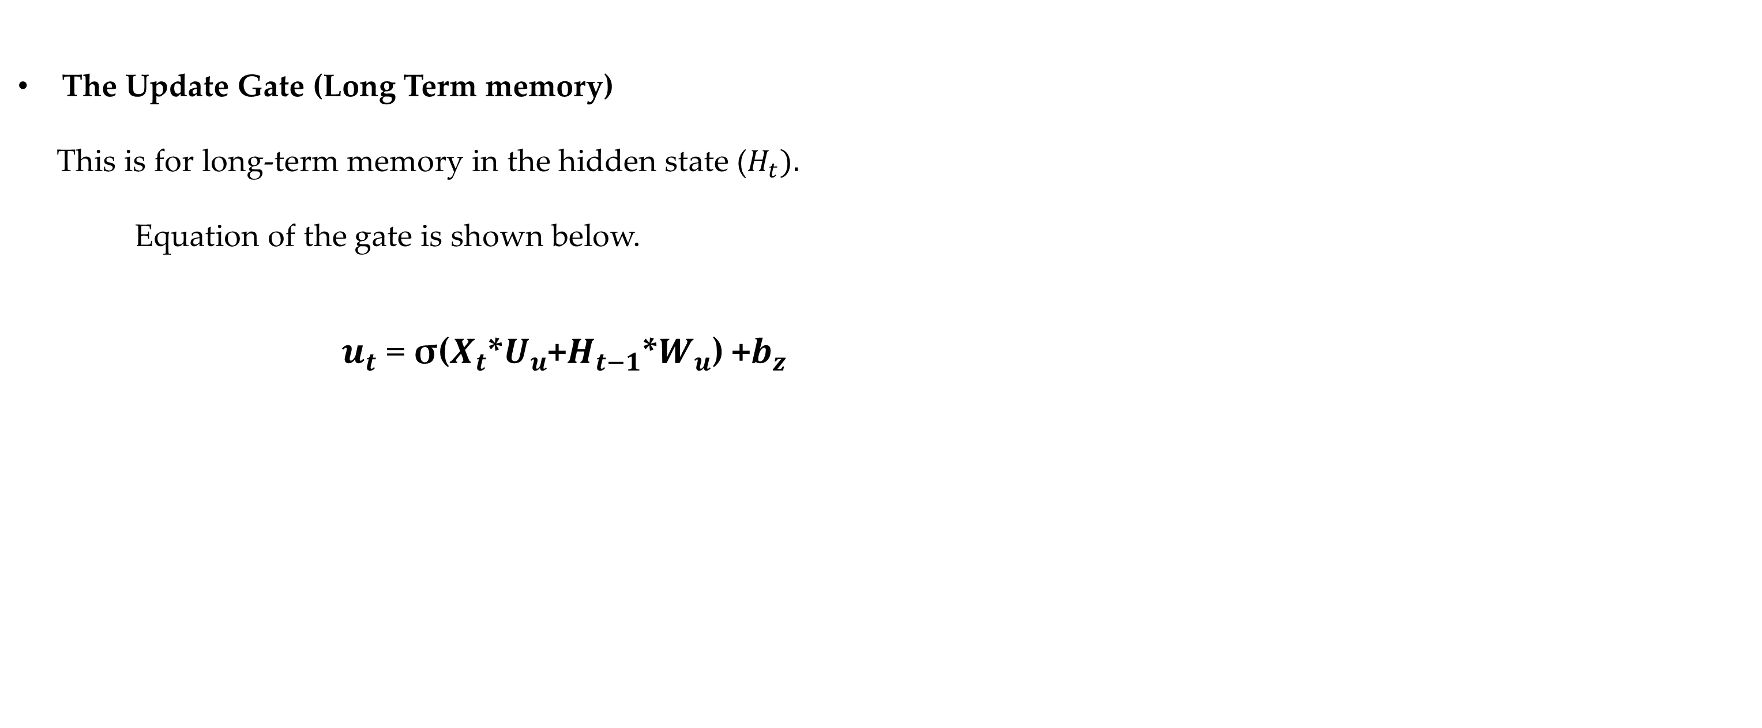
GRU Gate and memory allocation
The Update Gate (Long Term memory)
This is for long-term memory in the hidden state ($H_{t}).$
Equation of the gate is shown below.
$u_{t}$ = σ($X_{t}$*$U_{u}$+$H_{t−1}$*$W_{u}$) +$b_{z}$
Reference: https://tinyurl.com/5n933r7c
16

Slide 17
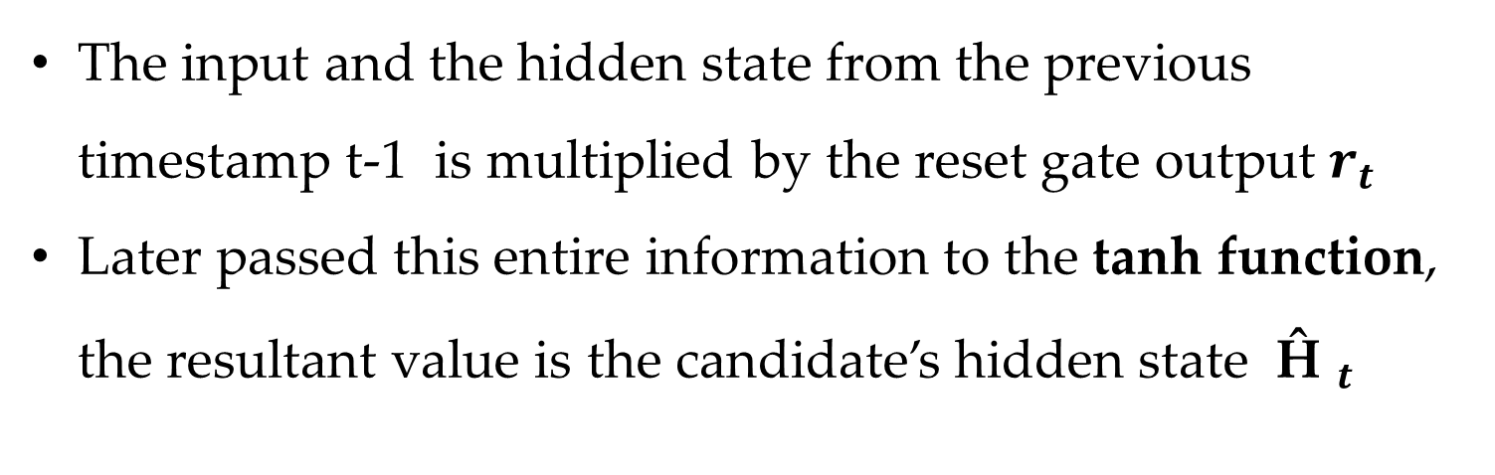
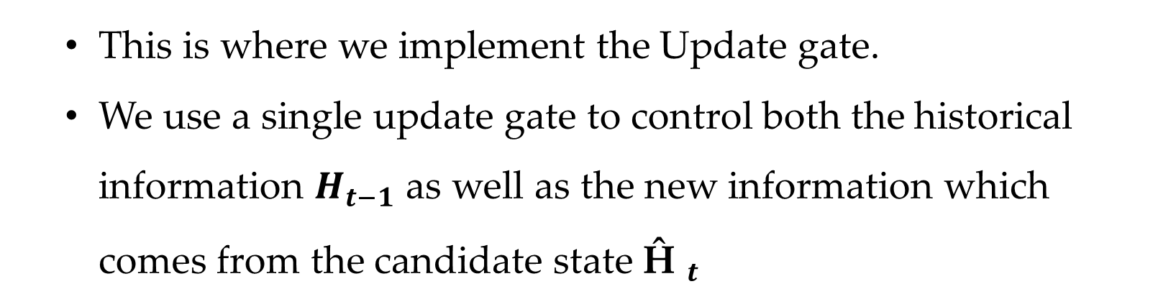
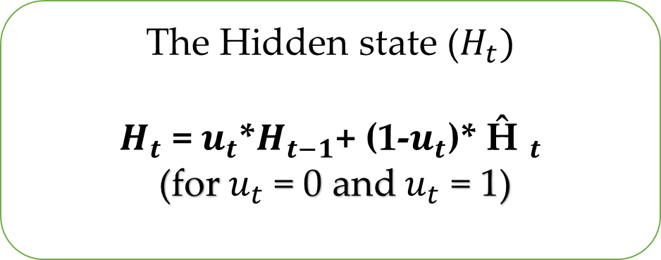
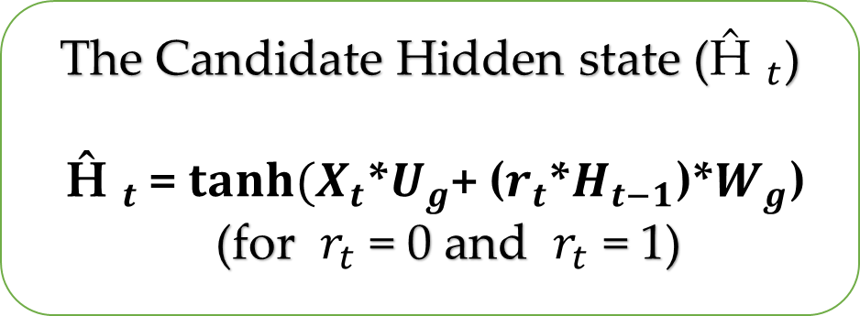
How GRU works
To find the Hidden state $H_{t}$, it follows a two-step process. The first step is to generate what is known as the candidate hidden state.
The Candidate Hidden state (${\text{Ĥ }}_{t}$)
${\text{Ĥ }}_{t}$ = $\tanh{(X_{t}}$*$U_{g}$+ ($r_{t}$*$H_{t−1}$)*$W_{g}$)
(for $r_{t}$ = 0 and $r_{t}$ = 1)
The input and the hidden state from the previous timestamp t-1 is multiplied by the reset gate output $r_{t}$
Later passed this entire information to the tanh function, the resultant value is the candidate’s hidden state ${\text{Ĥ }}_{t}$
This is where we implement the Update gate.
We use a single update gate to control both the historical information $H_{t−1}$ as well as the new information which comes from the candidate state ${\text{Ĥ }}_{t}$
The Hidden state ($H_{t})$
$H_{t}$ = $u_{t}$*$H_{t−1}$+ (1-$u_{t}$)* ${\text{Ĥ }}_{t}$
(for $u_{t}$ = 0 and $u_{t}$ = 1)
Reference: https://tinyurl.com/5n933r7c
17

Slide 18

Text prediction
Neural network itself is not equipped to handle language explicitly, they are just functional / mathematical operators [9].
We need to define a way to translate this text language into numerical encoding of a vector which then fed to a neural network generating a numerical vector.
But how??
example : A cute teddy bear is reading a book
Source: https://tinyurl.com/3k9mhrjr
18

Slide 19
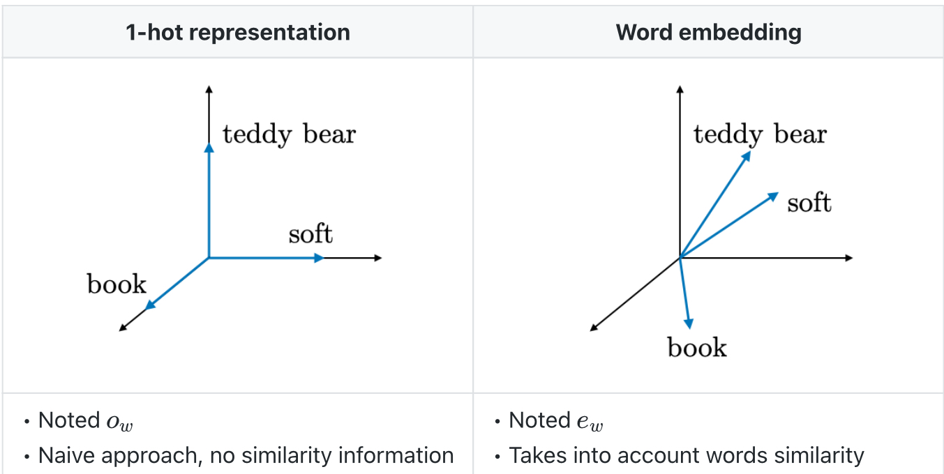
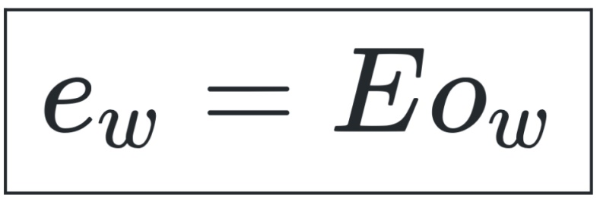
Embedding
E-embedding Matrix
Reference : https://tinyurl.com/n7djd7ax
19

Slide 20
Embedding
Bag of words/corpus of words Indexing Embedding
A
Cute
Teddy
Bear
Is
Reading
A
book
A---1
Cute-----2
Teddy -----3
Bear------4
.
.
.
.
Book-------n
One hot embedding
A-[0,0,0,0,1]
Cute-[0,0,0,1,0]
-
-
Learned embedding
a, is cute, teddy, bear
book reading
20

Slide 21
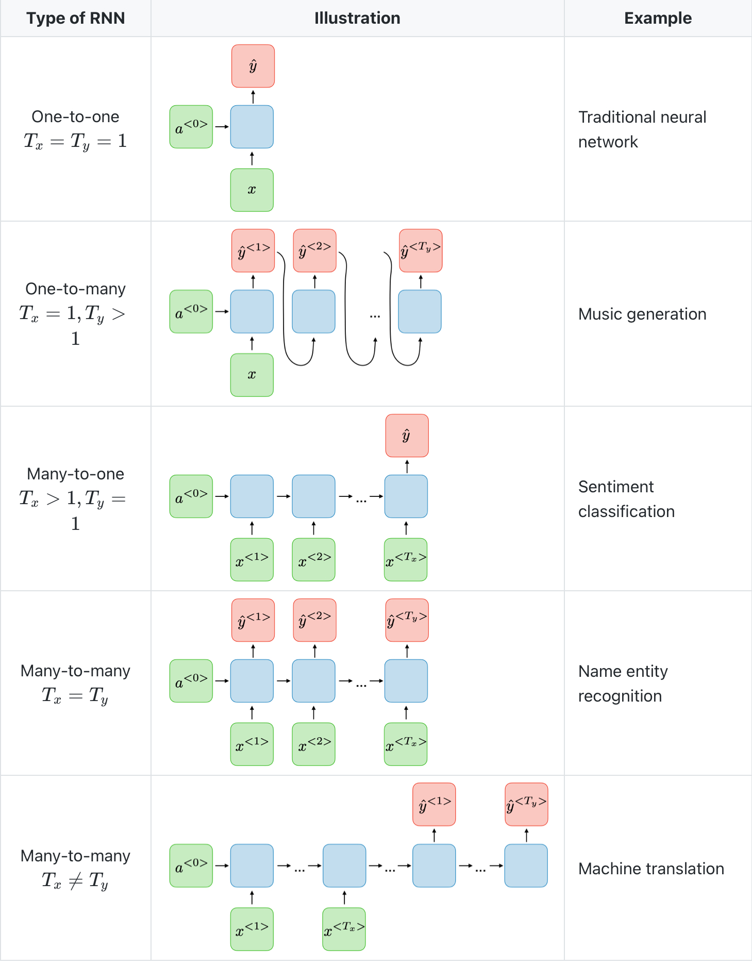
Types of RNN and their applications
Reference: https://tinyurl.com/n7djd7ax
21

Slide 22
Real-Life Applications of RNNs
Language Processing (LP)
RNNs are commonly used in LP tasks such as translation, sentiment analysis, and speech recognition.
Time-Series Analysis
RNNs can be used to analyze time-series data such as stock prices, weather patterns, and health records by studying trends and making future predictions
Image and Video Analysis
RNNs can derive information and write text comments on the image/ video. This process is known as computer vision .
22

Slide 23
Advantages of RNNs Limitation of RNNs
Ability to process sequential data.
Flexibility in handling variable-length inputs and outputs.
Memory of previous inputs can be retained and used to inform future predictions.
Can learn from past experiences and adjust its predictions accordingly
Encoding bottleneck -- practically challenging as we are encoding time step by time step into a single output at the very last . We must ensure all this is done smoothly which might result in output
Slow , no parallelization
Not long memory
23

Slide 24

Attention
The main goal of attention is to eliminate recurrence
Identify which parts to attend most important features in input
that are relevant to the semantic meaning of sentence.
Extract features with high attention.
Parameters - Query(Q) , Key(k) , Value(v).
Source: https://tinyurl.com/5n6u7jny
24

Slide 25
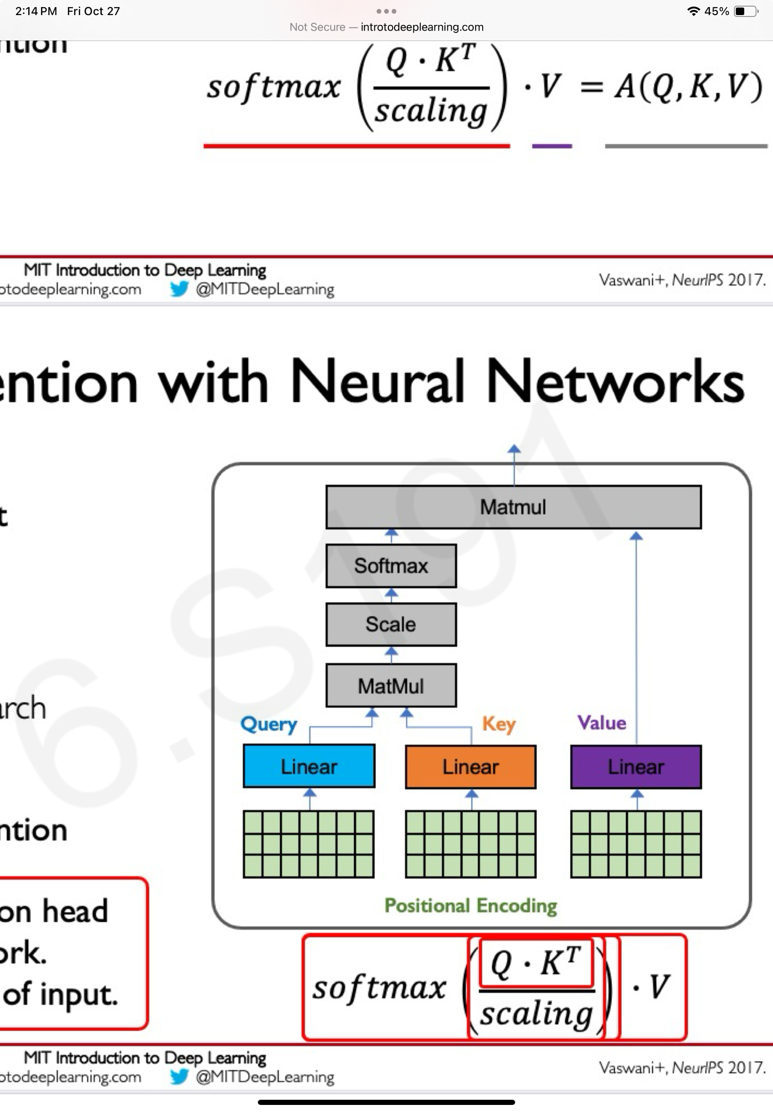
Positional encoding
Output
MatMul- Matrix multiplication
Scale-scaling
Softmax-converts a vector of k values into probability distribution
of K probabilities proportional to exponents of input numbers
Reference : https://tinyurl.com/2bn84tkk
25

Slide 26
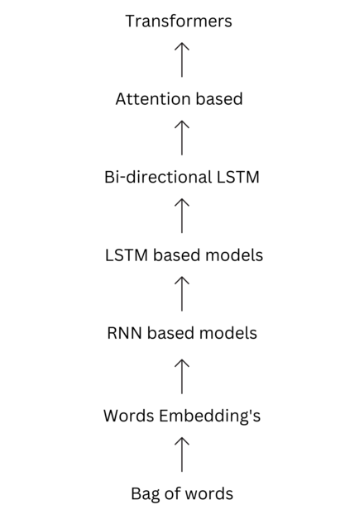
Transformers
Transformers is a deep learning architecture works on parallel multi headed attention mechanisms.
Common applications of transformers include
-Natural language processing.
-Computer vision.
-GPT(Generative pre-trained transformers)
-BERT(BI directional encoder representations from transformers
Fig: https://tinyurl.com/yrjhvwhd
26

Slide 27
Transformers
Encoding, decoding
Output
Attention-1
Attention-2
Attention-3
Reference : https://tinyurl.com/2bn84tkk
27

Slide 28
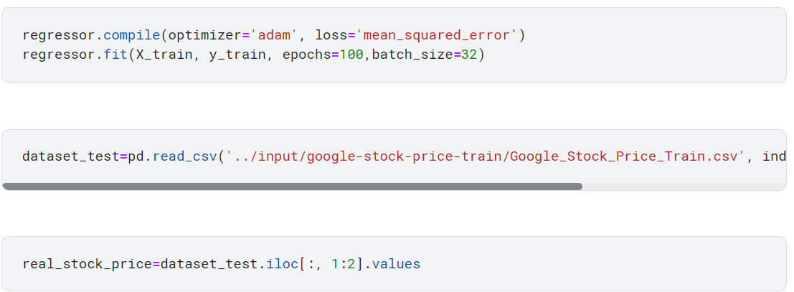
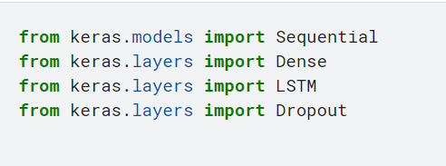
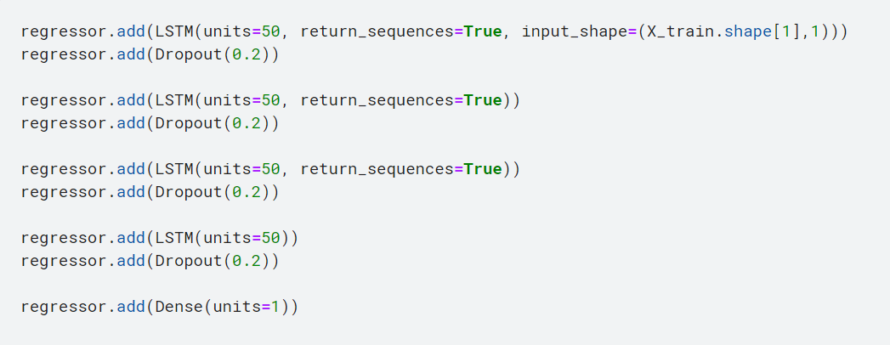
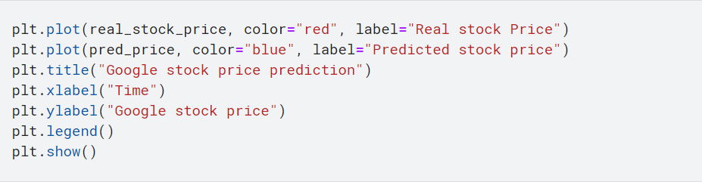
LSTM Code snippets
Importing, training & fitting dataset
28

Slide 29
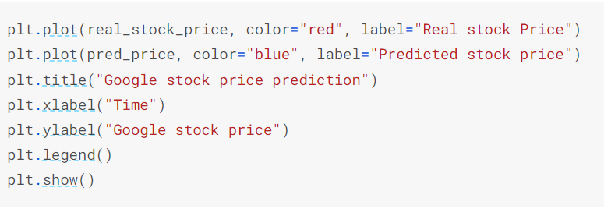
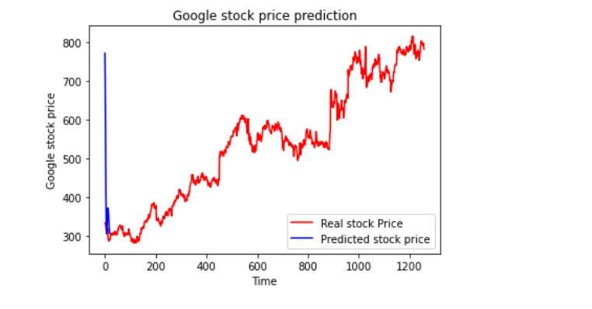
LSTM Prediction and Graph of real stock vs predicted stock price
29

Slide 30
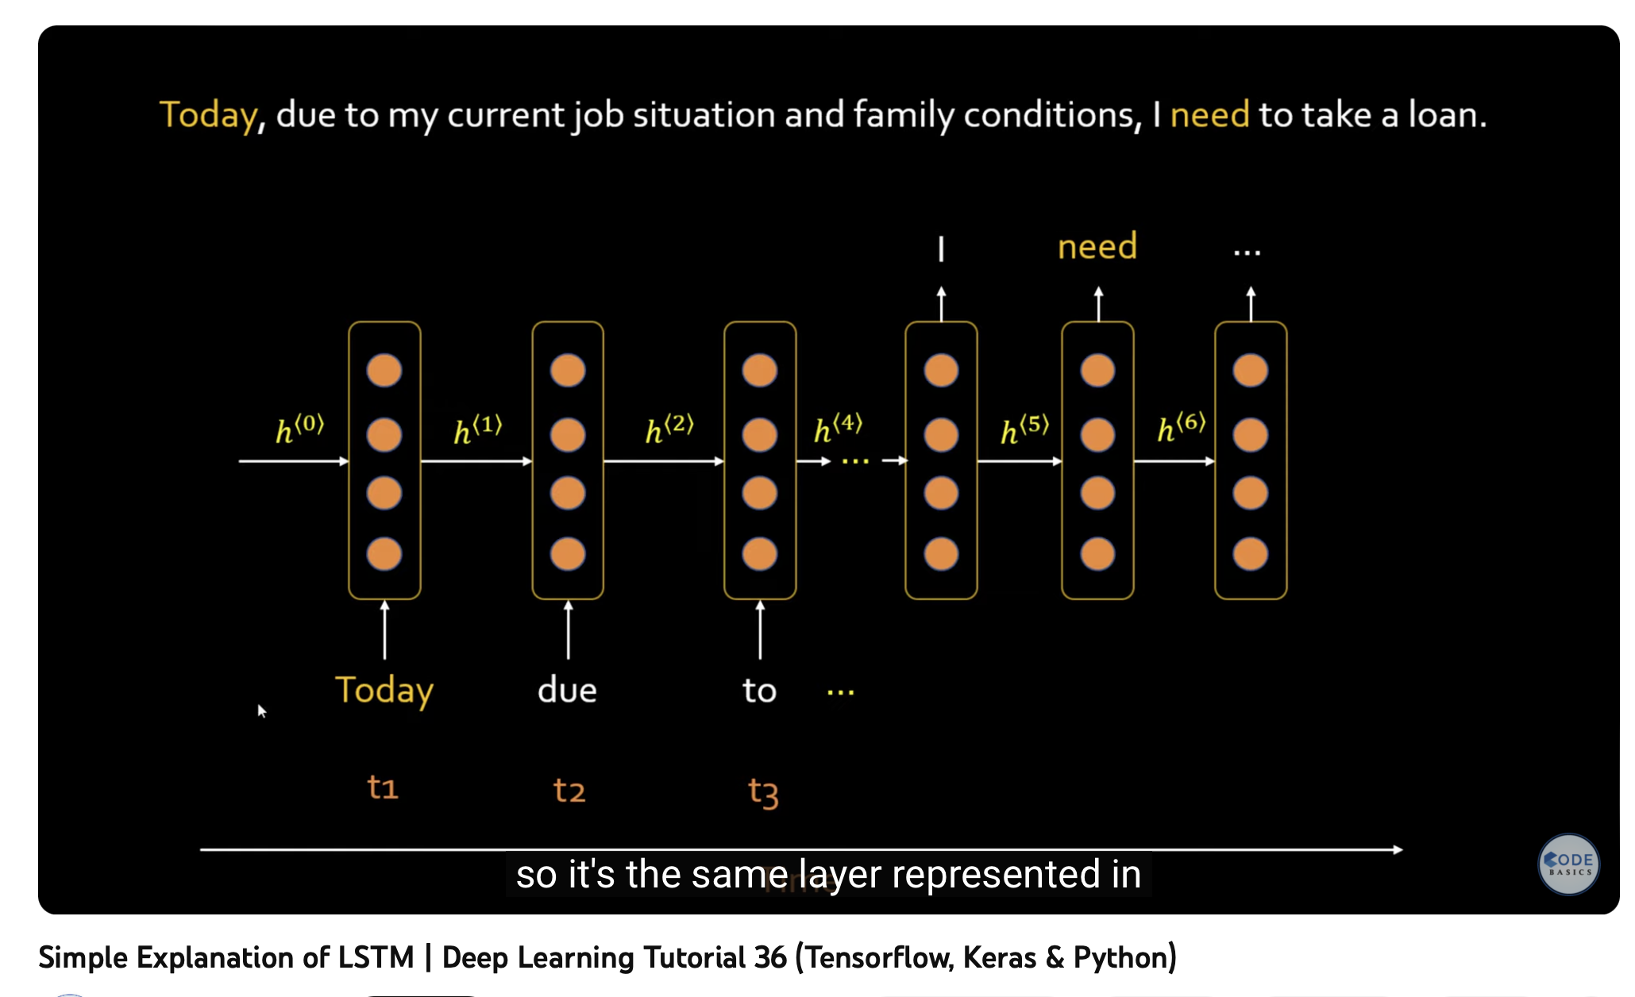
A short YouTube tutorial video on RNN
Reference: https://tinyurl.com/bdhv2npk
30

Slide 31
References
https://tinyurl.com/tsfcmx75
Zivkovic, S. (2020, November 14). # 005 RNN - Tackling Vanishing Gradients with GRU and LSTM. Master Data Science. https://tinyurl.com/rp8kfr6s
Recurrent Neural Network (RNN) | RNN LSTM Tutorial | Deep Learning Course | Simplilearn. (n.d.). PPT. https://tinyurl.com/3xyrn62w
https://tinyurl.com/dp3953za
Introduction to lstm -https://tinyurl.com/yc28s5pd
Understanding lstm- https://tinyurl.com/yc339ddr
Lstm - https://tinyurl.com/dp3953za
GRU- https://tinyurl.com/5n933r7c
MIT introduction to deep learning- https://tinyurl.com/2bn84tkk
Stanford. Edu RNN cheat sheet- https://tinyurl.com/n7djd7ax
Transforms Encyclopedia- https://tinyurl.com/yrjhvwhd
CODE: https://www.kaggle.com/code/faressayah/stock-market-analysis-prediction-using-lstm
31

Slide 32


